Slide 1
iGEM 2018 Review: ECUST
Synthetic Biology Review
By: Yogindra Raghav

Slide 2
Big Picture
Corrosion and blockage of cooling towers (damage ~ $1 billion)
Genetically engineer E. Coli: concurrent expression of dispersin and siderophore.
Receive signal for expressing antimicrobial peptide
Maintenance ACCOMPLISHED!

Slide 3
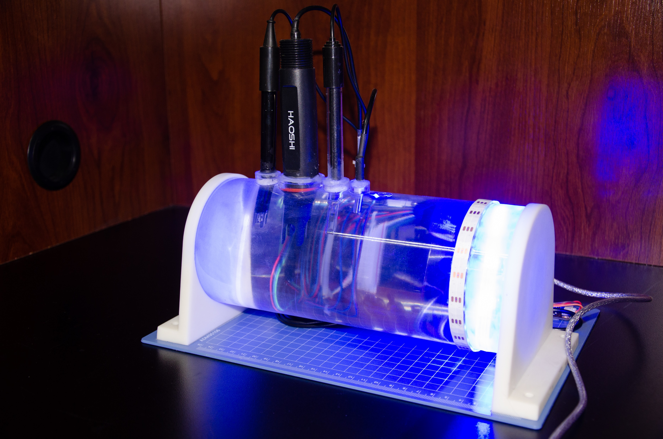
“Parts” and “Devices” ╪
Parts:
Iron-sensitive transcription factors
E. Coli edited with antimicrobial capability
Devices:
iTube pipeline
ORP
pH
Conductivity
Temperature
╪ as defined by the field of synthetic biology

Slide 4
